Slide 1
SILVERTRUST AI CONSULTING
Fleet Cost Intelligence
50 trucks
Fleet size
Dashboard
€850k
Annual fuel spend
AI-powered fuel anomaly detection for regional haulage SME
178%
Year 1 ROI
Pedro Biain - Silver Trush Consulting

Slide 2
THE PROBLEM
Chleo runs a 50-truck haulage company in Spain.
She gets one fuel bill at month-end. That's all.
?
!
$
x
No visibility
Month-end surprises
Margin erosion
Manual chaos
Can't see which trucks or routes are burning excess fuel
Anomalies discovered too late to act on
Fuel is 30-35% of costs on a 2-3% net margin
Dispatch runs on calls, WhatsApp, and Excel

Slide 3
THE SOLUTION
Three use cases. Phased. Transparent. Built on data you already have.
01
Fuel Dashboard
Real-time fuel anomaly detection per truck, driver, and route. Built on your existing TMS and fuel card data.
Tableau
02
Ops Alerts
Daily automated alerts when a truck burns 20%+ above average. Email, Google Sheets, Airtable — zero manual work.
n8n
03
AI Insights
Weekly natural language insights from the fleet data. Every AI decision logged and auditable — full transparency.
LangSmith

Slide 4
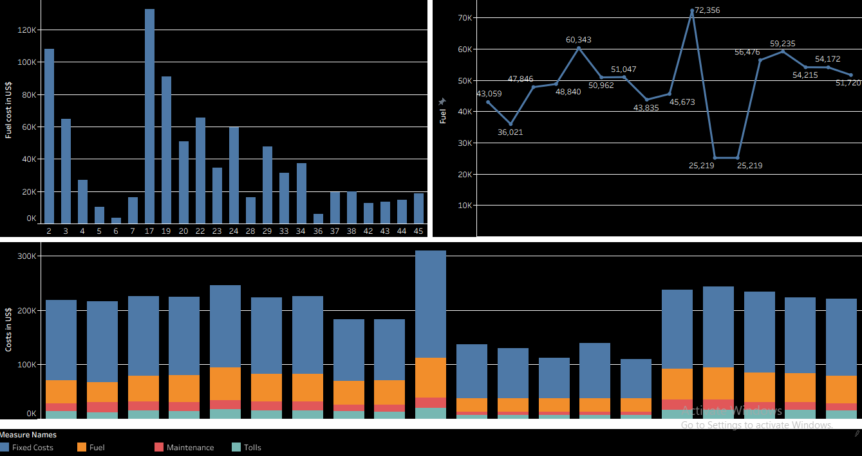
TABLEAU DASHBOARD
Fleet Cost Intelligence Dashboard
€901k
Total fuel spend
Truck 17
Top anomaly
3 charts
One view

Slide 5
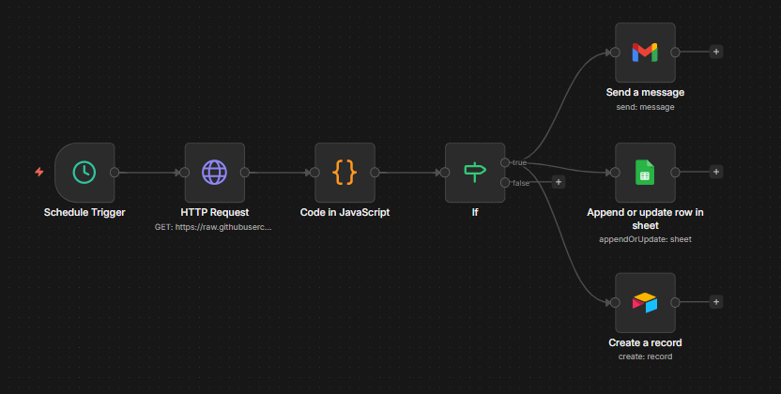
N8N WORKFLOW
Fuel Anomaly Alert — runs every morning at 8am
Schedule
HTTP
JavaScript
IF node
Gmail
Sheets + Airtable
Daily 8am
Read CSV
Detect anomalies
Route alerts
Email alert
Log records

Slide 6
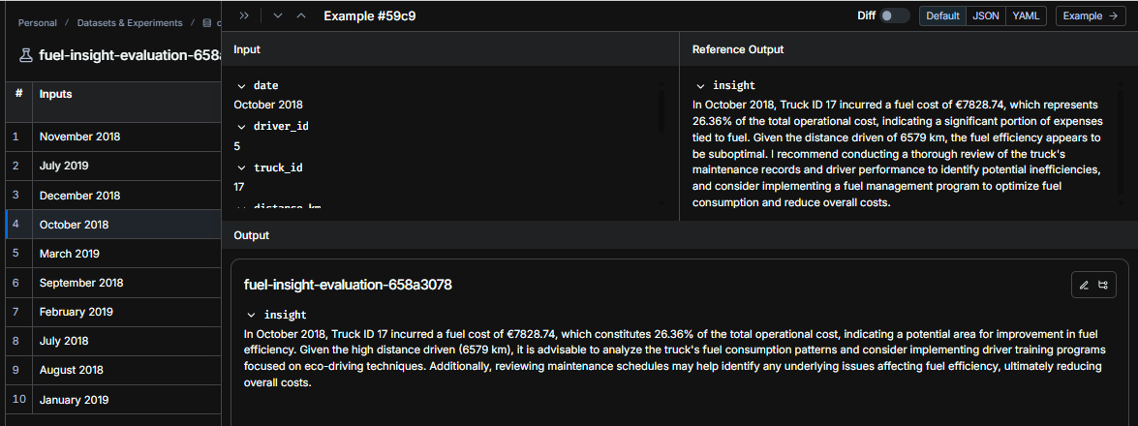
LANGSMITH MONITORING
Proof that AI is not a black box
10
2.3s
1.00
0.94
Examples tested
Response time
Actionability
Insight quality

Slide 7
BUSINESS CASE
The numbers make the case for themselves
€20k
Total setup cost
€55.6k
Year 1 net saving
178%
Year 1 ROI
4.3 mo
Payback period

Slide 8
IMPLEMENTATION PLAN
24 weeks. Phased. Starting with quick wins.
Phase 1 — UC2
Phase 2 — UC1
Phase 3 — UC3
Weeks 1–4
Weeks 5–12
Weeks 13–24
Ops alerts only
Fuel dashboard + AI
Full optimisation
n8n automated alerts
Tableau dashboard live
Advanced LangGraph agent
Gmail + Sheets + Airtable
AI insight agent
Driver performance scoring
Payback in 9 days
LangSmith monitoring
Predictive maintenance
€2,500
€10,000
€7,500

Slide 9
AI IS NOT A BLACK BOX.
It's a system with inputs, outputs, and full observability.
Transparent
Measurable
Profitable
Every AI decision logged in LangSmith — input, output, score, latency
0.94 insight quality score across 10 evaluated examples
178% ROI in year 1. Payback in 4.3 months on a 50-truck fleet
Pedro Biain | SilverTrust AI Consulting | pbiain@gmail.com

